Slide 1
Lecture 11-(a): Population Games: Motivation

Slide 2
Contents
Two examples for motivating population games
1. Drawing an interesting situation from a symmetric normal-form game
2. Non-atomic congestion game
Generalization of population will follow soon

Slide 3
Example 1: Hawk-Dove Game
Interpret the payoffs as corresponding to fitness, e.g., greater consumption of resources leads to more offspring

Slide 4
Hawk-Dove Game: Wait! I saw this
Entire population is divided into the following portions depending on their strategy choices $x=(x_{h},x_{d})$
This can be understood as a mixed strategy profile in the normal form game
Mixed Strategy NE?
Ah-ha! In this case, a strategy is nothing but a vector of portions of humans $x=(x_{h},x_{d})$, where each portion corresponds to each strategy
A person’s choice of a strategy s in the normal-form game == A portion of people who chooses the strategy s

Slide 5
Different Angle: Hawk-Dove Game
Consider a society consisting of “many” (mathematically infinite) humans who want to have more offspring
Assume
Each infinitesimal human is matched to play the game, where each pair of humans meet exactly once.
Entire population is divided into the following portions depending on their strategy choices $x=(x_{h},x_{d})$
What is the (average) payoff of choosing strategy “Hawk”?
What is the (average) payoff of choosing strategy “Dove”?
Maybe, using this way, we can understand how animals behave in the jungle?

Slide 6
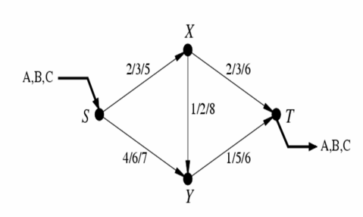
Another example: Congestion Game
Three players from S to T (A,B,C)
a/b/c: cost when one/two/three players use that road
Total cost of each player is the aggregate link cost over its path

Slide 7
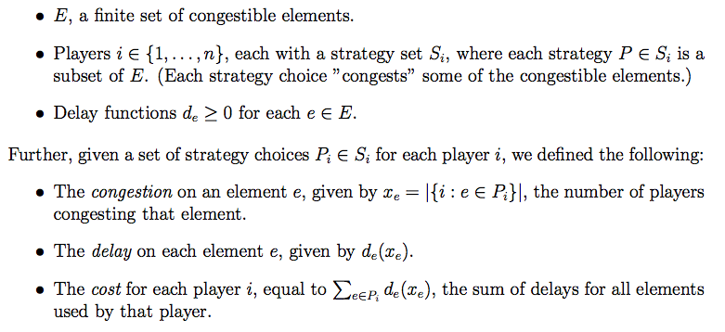
Earlier Model

Slide 8
A different, yet similar congestion game
Three classes (or types) from S to T (A,B,C)
Each class is a player
Multiple classes are playing the game
Each class has its mass, say $r_{i}$ (equivalently the rate of traffic that needs to be delivered by class i.
Each class selects a strategy from the strategy set $S_{i}$
Each class of players is allowed to distribute fractionally over the strategy set

Slide 9
Difference between Two Games
Unsplittable (atomic) congestion game
A finite number of users
Each user chooses a path on which he transports all of his load
Splittable (non-atomic) congestion game
Treat traffic similarly to flow in a network where we can split up the load to several paths
Analogously, we can look it as (infinitely many users, where each user controls infinitesimal portion of the total traffic
This motivates a notion of “population game”

Slide 10
More general stories will follow

Slide 22
Lecture 11-(c): Population Games: Equilibrium

Slide 23
Nash Equilibrium of Population Game
Essentially,
It’s equal to finding the mixed NEP of the game
Social states refer to the probabilistic distribution over the strategies of all populations
But, there exists other notions of equilibrium that is worth considering
Evolutionary stable strategy

Slide 24
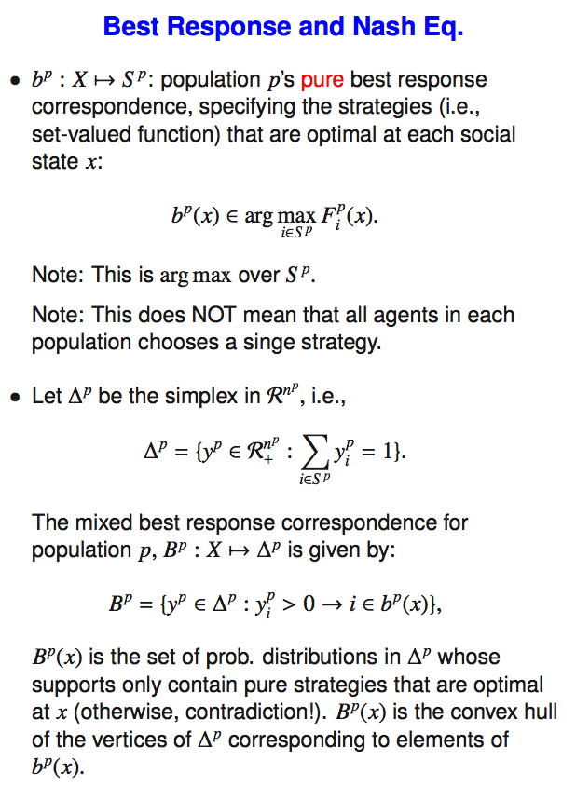

Slide 26
Again: Hawk-Dove Game (was a HW prob.)

Slide 27
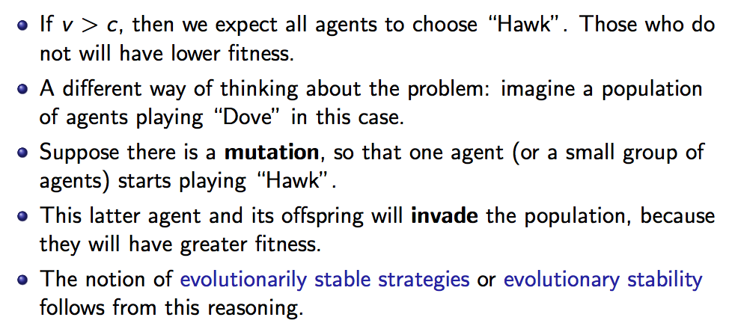
Evolution in the H-D Game

Slide 29
Locally stable

Slide 30
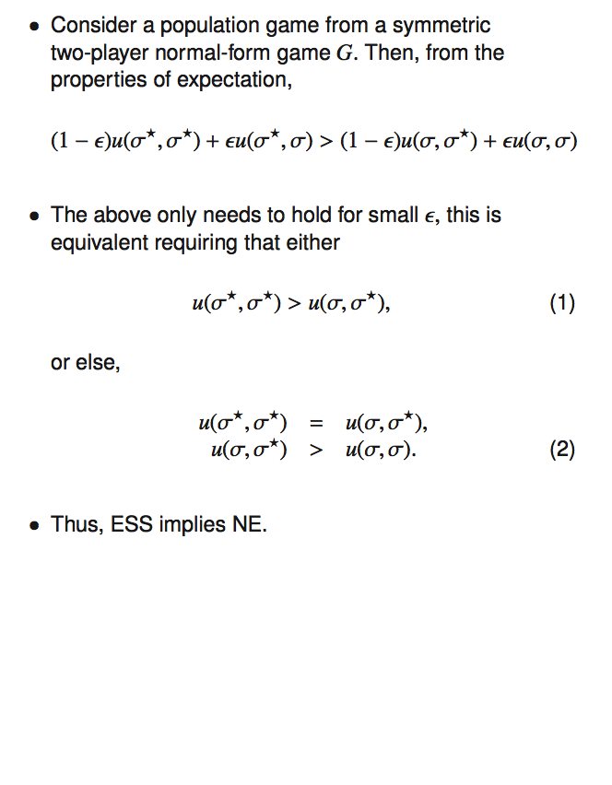
Homework: Prove that the above things are equivalent.

Slide 31
ESS and NE

Slide 32
Monomorphic vs. Polymorphic

Slide 33
Back to: Hawk-Dove Game

