Slide 1
Lecture 1:
Intro to Game Theory

Slide 2
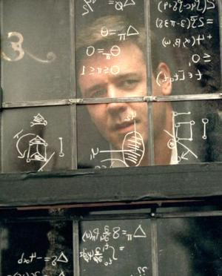

“A Beautiful Mind” (2001)

Slide 3
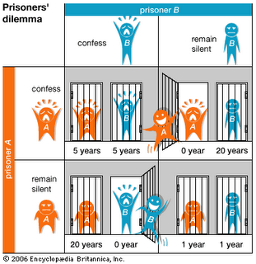
Sneak Peek: Prisoner’s Dilemma

Slide 4


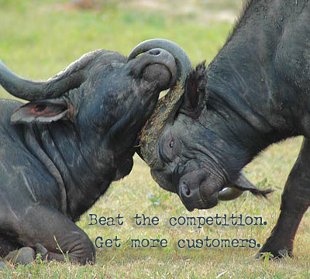
What is Game Theory?
(Distributed) Optimization Theory
  Optimize a single objective over a design variable x,
Game theory
  Study of multi-person decision problems
  Competition and cooperation among agents
  Role of threats/punishments in long-term relations
  Models of adversarial behavior

Slide 5
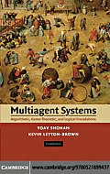

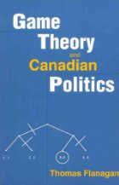
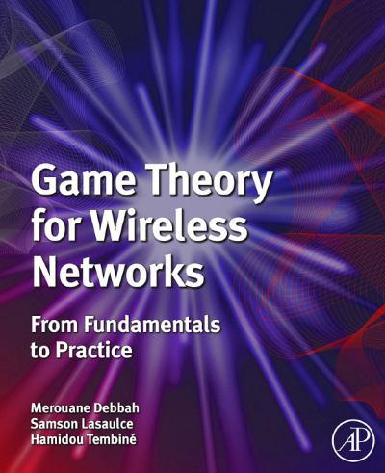
Applications of Game Theory
Theory developed mainly by mathematicians and economists
  contributions from biologists
Widely applied in many disciplines
  from economics to philosophy, including computer science (Systems, Theory and AI)
  goal is often to understand some phenomena

Slide 6
Limitations of Game Theory
No unified solution to general conflict resolution
Real-world conflicts are complex
  models can at best capture important aspects
Players are (usually) considered rational
  determine what is best for them given that others are doing the same
No unique prescription
  not clear what players should do
But it can provide intuitions, suggestions and partial prescriptions
  best mathematical tool we currently have

Slide 7
What is a Game?
A Game consists of
  at least two players
  a set of strategies for each player
  a preference relation over possible outcomes
Player is general entity
  individual, company, nation, protocol, animal, etc
Strategies
  actions which a player chooses to follow
Outcome
  determined by mutual choice of strategies
Preference relation
  modeled as utility (payoff) over set of outcomes

Slide 8
Classification of Games
Many, many types of games
  Two major categories
Non-Cooperative Games
  individualized play, no bindings among players
  What strategies do I have to take when other strategic (rational) people interact with me?
Cooperative Games
  play as a group, possible bindings
  What advantages are given to me if I cooperate with others in the group?
  Whom do I have to make a coalition with in order to maximize the gain given to me?

Slide 9
Example 1: WiFi MAC Access
Access Point
Nodes are required to follow Medium Access Control (MAC) rules
Wireless channel
A
B
Misbehaving nodes may violate MAC rules
: access probability, different backoff times

Slide 10

Example 2: Uplink Power Control
Network with a single point of interest
Uplink transmission
My power will make significant impact on the throughputs of other mobiles at the BS
Strategic situation
How can we model and analyze this system?

Slide 11
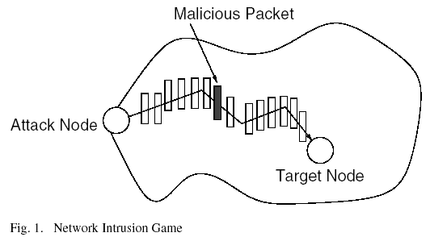
Example 3: Security
An intruder who sends a malicious packet to a node in the network
A defender who uses packet sampling on links in an attempt to detect this intrusion

Slide 12
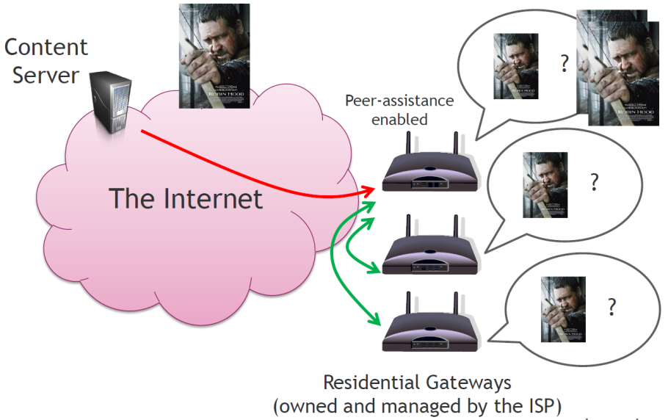
Example 4: Peer-Assisted Service
Client-Server
  Limited by server side’s capability: access bandwidth and computing power
P2P
  Exponential capacity growth and significant reduction of delivery cost
  Too much copyright violation
Peer-assisted Services
  Peers legally assist CP by commitment
  Examples deployed: Nano data center and IPTV
Question:
How to incentivize peers?
What kind of viable revenue sharing
principle among CP and peers?

Slide 13
Two Views of Game Theory
As an analysis tool
  Model of a strategic situation and study what situation we will end up with having
  Example: Analysis of Coke market (Coca Cola and Pepsi)
As a control tool
  Development of a control mechanism that leads to a “good” conclusion
  Inverse game theory or often called mechanism design
  Example: Auction

