Slide 1
C++ and Objected Oritend Programming
Yung Yi

Slide 2
Ack
Big Thanks
  These slides are largely borrowed from Prof. Takgon Kim’s Slides
Also, reconfigured, restructured, and added by
Prof. Yung Yi

Slide 3
Goals of This Lecture
Overview of C++ language
  At a glance, C++ = C + Class
Intro to object-oriented (OO) programming
  In structured programming, program = a series of functions
  In OO programming, program = interaction between objects
  OO encourages abstraction
    Effective in representing a complex problem
  OO encourages software reuse
    Easily reuse classes and their implementation

Slide 4
Objected Oriented
Programming

Slide 5
The C++ Programming Model
CoolProgram.cpp
a.out
Library Functions
Compiler
User

Slide 6
A Simple C++ Program
Two integer inputs x and y
Output their sum
#include <cstdlib>
#include <iostream>
/* This program inputs two numbers x and y and outputs their sum */
int main( ) {
int x, y;
std::cout << “please enter two numbers: ”
std::cin >> x >> y; // input x and y
int sum = x + y; // compute their sum
std::cout << “Their sum is ” << sum << std::endl;
return EXIT_SUCCESS // terminate successfully
}

Slide 7
Abstraction and Abstract Data Type
Abstraction: depends on what to focus
  Procedure abstraction: focuses on operations
  Data abstraction: data + operations as one
  Object abstraction: data abstraction + reusable sub types (class)
Abstract data type (ADT)
  Definition of a set of data + associated operations
Implementation of ADT
  Data → data structure
    Stack, Queue, Tree etc.
  Operations → manipulation of data structure
    Stack: push, pop etc.
  Error conditions associated with operations

Slide 8
Example of ADT
Example: ADT modeling a simple stock trading system
  The data stored are buy/sell orders
  The operations supported are
    order buy(stock, shares, price)
    order sell(stock, shares, price)
    void cancel(order)
  Error conditions:
    Buy/sell a nonexistent stock
    Cancel a nonexistent order

Slide 9
C & C++ in Abstraction View
C supports Procedure-Oriented programming
  Procedure (function) + data structure
    Procedure (function) : manipulate data
C++ supports Object-Oriented programming
  Object-oriented programming (OOP) is a programming paradigm that uses objects and their interactions to design applications and computer programs.
  Data abstract + reusable subtypes with following features
    Encapsulation, Polymorphism, Inheritance

Slide 10
Procedural-Oriented VS. Object-Oriented
Procedural-Oriented Program
Object-Oriented Program
main
Object-1
data
function-1
(procedure)
data-1
+
functions
Object-2
data
data-2
+
functions
function-2
(procedure)
data
Object-n
Object-3
function-3
(procedure)
data-4
+
functions
data-3
+
functions
data
data is open to all functions.
Each data is hidden and associated with an object.

Slide 11
Example: PO VS. OO
CAR
Procedure-oriented View
of car operation
Object-oriented View
of car operation
steering wheel
accelerator
brakes
switch on the ignition
accelerate
tires
engine
steer
brake
Car = a sequence of functions (procedures)
Car = interaction between components (objects)

Slide 12
What is Object ?
Class (↔ Type in C )
  Defines the abstract characteristics of a thing (object)
    attributes (data) + behaviors (operations = methods)
Object (↔ Variable in C )
  A pattern (exemplar) of a class
Instance
  The actual object created at runtime
  State: the set of values of the attributes of a particular object
Methods
  functions
Car
Class
Attributes
: color, capacity, max. speed, …
Methods
: accelerate, brake, steer left, steer right, …
Ferrari
Hyundai
Object
(Instance at runtime)

Slide 13
C++ Classes
Similar to structure in C
Class in C++
Structure in C
class class_name {
public:
// member variables
int a, b, c;
…
// member methods (functions)
void print(void);
…
} ;
struct tag_name {
type1 member1;
type2 member2;
…
typeN memberN;
} ;
a collection of types and
associated functions
a collection of heterogeneous types

Slide 14
Class Declaration
class_name instance_name1, instance_name2;
C.f. struct tag_name struct_variable, … ;
class_name
instantiation
instance_name2
variables
variables
methods
instance_name1
methods
variables
methods

Slide 15
C Style Design (Procedural) (1/2)
Bank
Client
data
operations
data
operations
Client
name
name
telephone no.
telephone no.
withdrawal
withdrawal
account no.
account no.
deposit
password
…
password
deposit
balance
…
balance
…
…

Slide 16
C Style Design (Procedural) (2/2)
Array of structures
Structure
Functions
Bank
struct client {
char name[MAX];
char tel[MAX];
char account[MAX];
char password[MAX];
int balance;
};
Client
name
telephone no.
withdrawal
account no.
deposit
password
…
balance
…
struct client clients[MAX_NO];
…
void withdrawal (client &cli, int money);
void deposit (client &cli, int money);
references

Slide 17
C++ Style Design (Object-Oriented) (1/2)
Bank
Client
data
operations
Client
name
name
withdrawal
telephone no.
telephone no.
deposit
withdrawal
account no.
account no.
…
…
password
password
deposit
balance
balance
…
…

Slide 18
C++ Style Design (Object-Oriented) (2/2)
Bank
Class
class client {
char name[MAX];
char tel[MAX];
char account[MAX];
char password[MAX];
int balance;
void withdrawal (int money);
void deposit (int money);
};
client clients[MAX_NO];
Client
name
withdrawal
telephone no.
deposit
account no.
…
…
password
balance
member variables
are not required
…
“struct” can be omitted in C++
In C++, structure is a class with all members public.
struct s { , , , } ≡ class s {public: , , , }

Slide 19
Example: Class
#include<iostream> #define MAX 10 using namespace std; class record{ public: char name[MAX]; int course1, course2; double avg; void print(void) { cout << name << endl; cout << “course1 = ” << course1 << “, course2 = ” << course2 << endl; cout << “avg = ” << avg << endl; } }; | int main( ) { record myrecord; myrecord.name = “KIM JH”; myrecord.course1 = 100; myrecord.course2 = 90; int sum = myrecord.course1 + myrecord.course2; myrecord.avg = ((double) sum) / 2; myrecord.print( ); return 0; }
instantiation
referencing
public member variables
Access specifier
member variables
member function call
member function
result> KIM JH course1 = 100, course2 = 90 avg = 95

Slide 20
Definition of Member Functions
whole code in same file
ex) “record.cpp”
 | class record{ public: char name[MAX]; int course1, course2; double avg; void print(void); }; void record::print(void) { cout << name << endl; cout << “course1 = ” << course1 << “, course2 = ” << course2 << endl; cout << “avg = ” << avg << endl; }
class record{ public: char name[MAX]; int course1, course2; double avg; void print(void) { cout << name << endl; cout << “course1 = ” << course1 << “, course2 = ” << course2 << endl; cout << “avg = ” << avg << endl; } };
declaration
“record.h”
definition :
always after declaration
“record.cpp”
declaration & definition
don’t miss #include “record.h” in “record.cpp”

Slide 21
Member Variables & Functions
#include<iostream> #define MAX 10 using namespace std; class record{ public: char name[MAX]; int course1, course2; double avg; void print(void) { cout << name << endl; cout << “course1 = ” << course1 << “, course2 = ” << course2 << endl; cout << “avg = ” << avg << endl; } };
 | int main( ) { record myrecord; myrecord.name = “KIM JH”; myrecord.course1 = 100; myrecord.course2 = 90; int sum = myrecord.course1 + myrecord.course2; myrecord.avg = ((double) sum) / 2; myrecord.print( ); return 0; }
always must reference
member variables
with instance name
can reference member variables
without class name
inside member functions
member function

Slide 22
Encapsulation
Encapsulation conceals the functional details defined in a class from external world (clients).
  Information hiding
    By limiting access to member variables/functions from outside
  Operation through interface
    Allows access to member variables through interface
  Separation of interface from implementation
    Similar to Stack data type and implementation (Lecture 11)
no necessity for
knowing inside
encapsulation
clients (users) only
know interface.

Slide 23
Encapsulation in C++
Class in C++
class class_name {
public:
int a, b, c;
…
void print(void);
…
private:
…
protected:
…
} ;
Interfaces : open outside
Access specifier
Encapsulation: hide inside

Slide 24
Basic Features
(Mostly same as C)

Slide 25
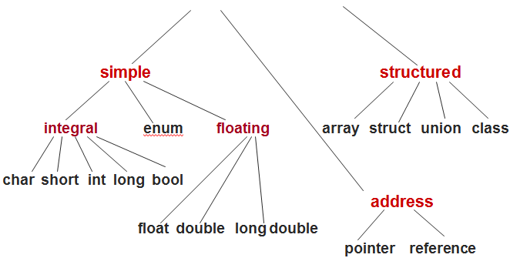
C++ Data Types
C++ Data Type

Slide 26
Fundamental Types
Basic data types
  bool Boolean value, either true or false
  char Character
  short Short integer
  int Integer
  long Long integer
  float Single-precision floating-point number
  double Double-precision floating-point number
  enum User-defined type, a set of discrete values
  void The absence of any type information

Slide 27
Declaration of a Variable
We can provide a definition, or initial value
Without definition, initial value is zero
Variable names may consist of any combination of letters, digits, or the underscore (_) character, but the first character cannot be digit
ex)
short n;
int octalNumber = 0400;
char newline_character = ‘＼n’;
long BIGnumber = 314159265L;
short _aSTRANGE__1234_variABlE_NaMe;

Slide 28
Characters: char
Typically 8-bit
Literal
  A constant value appearing in a program
  Enclosed in single quotes
  A backslash (＼) is used to specify a number of special character literals
‘＼n’ newline ‘＼t’ tab
‘＼b’ backspace ‘＼r’ return
‘＼0’ null ‘＼’’ single quote
‘＼”’ double quote ‘＼＼’ backslash

Slide 29
Integers: short, int, long
Short int, (plain) int, long int
Decimal numbers
  ex) 0, 25, 98765, -3
Suffix “l” or “L” indicate a long integer
  ex) 123456789L
Prefix “0” indicates octal constants
  ex) 0400 (256)
Prefix “0x” indicates hexadecimal constants
  ex) 0x1c (28)

Slide 30
Floating Point: float, double
Floating point literals
  ex) 3.14159, -1234.567, 3.14E5, 1.28e-3
Default is double type
Suffix “f” or “F” indicate float
  ex) 2.0f, 1.234e-3F

Slide 31
Enumerations: enum
A user-defined type that can hold any of a set of discrete values
Once defined, enumerations behave much like an integer type
Each element of an enumeration is associated with an integer value
ex)
enum Color {RED, GREEN, BLUE}; //RED=0, GREEN=1, BLUE=2
enum Mood {HAPPY=3, SAD=1, ANXIOUS=4, SLEEPY=2};
Color skycolor = BLUE;
Mood myMood = SLEEPY;

Slide 32
Pointers
Pointer holds the value of an memory address
The type T* denotes a pointer to a variable of type T
  ex) int*, char*
The ‘address-of’ operator, ‘&’, returns the address of a variable
Dereferencing
  Accessing the object addressed by a pointer
  Done by * operator

Slide 33
Pointers
ex)
Null pointer points to nothing
Void type pointer can point to a variable of any type
Cannot declare a void type variable
char ch = ‘Q’;
char* p = &ch; // p holds the address of ch
cout << *p; // outputs the character ‘Q’
ch = ‘Z’; // ch now holds ‘Z’
cout << *p; // outputs the character ‘Z’

Slide 34
Arrays
A collection of elements of the same type
Index references an element of the array
Index is a number from 0 to N-1
ex)
double f[3]; // array of 3 doubles: f[0], f[1], f[2]
double* p[10]; // array of 10 double pointers: p[0], ... , p[9]
f[2] = 25.3;
p[4] = &f[2]; // p[4] points to f[2]
cout << *p[4]; // outputs “25.3”

Slide 35
Arrays
Two-dimensional array
  An “array of arrays”
  ex) int A[15][30]
Initializing
  ex)
int a[4] = {10, 11, 12, 13}; // declares and initializes a[4]
bool b[2] = {false, true}; // declares and initialize b[2]
char c[] = {‘c’, ‘a’, ‘t’}; // declares and initialize c[3]
// compiler figures the size of c[]

Slide 36
Pointers and Arrays
The name of an array can be used as a pointer to the array’s initial element and vice versa
ex)
char c[] = {‘c’, ‘a’, ‘t’};
char *p = c; // p point to c[0]
char *q = &c[0]; // q also points to c[0]
cout << c[2] << p[2] << q[2] // outputs “ttt”

Slide 37
C-Style Structure
Storing an aggregation of elements which can have different types
These elements called “member” or “field”, is referred to by a given name
ex)
enum MealType { NO_PREF, REGULAR, LOW_FAT, VEGETARIAN };
struct Passenger {
string name; // possible value: “John Smith”
MealType mealPref; // possible value: VEGETARIAN
bool isFreqFlyer; // possible value: true
string freqFlyerNo; // possible value: “293145”
};

Slide 38
C-Style Structure
This defines a new type called Passenger
Declaration and initialization
  ex)
Member selection operator
  struct_name.member
  ex)
This is just for backward-compatibility
``Class” is much more powerful
Passanger pass = { “John Smith”, VEGETARIAN, true, “293145” }
pass.name = “Pocahontas”; // change name
pass.mealPref = REGULAR; // change meal preference

Slide 39
References
An alternative name for an object (i.e., alias)
The type T& denotes a reference to an object of type T
Cannot be NULL
ex)
string author = “Samuel Clemens”;
string &penName = author; // penName is an alias for author
penName = “Mark Twain”; // now author = “Mark Twain”
cout << author; // outputs “Mark Twain”

Slide 40
Constants
Adding the keyword const to a declaration
The value of the associated object cannot be changed
ex)
Replace “#define” in C for the definition of constants
const double PI = 3.14159265;
const int CUT_OFF[] = {90, 80, 70, 60};
const int N_DAYS = 7;
const int N_HOURS = 24*N_DAYS; // using a constant expression
int counter[N_HOURS]; // constant used for array size

Slide 41
Typedef
Define a new type name with keyword typedef
ex)
typedef char* BufferPtr; // type BufferPtr is a pointer to char
typedef double Coordinate; // type Coordinate is a double
BufferPtr p; // p is a pointer to char
Coordinate x, y; // x and y are of type double

Slide 42
Dynamic Memory Allocation

Slide 43
Dynamic Memory and ‘new’ Operator
Create objects dynamically in the ‘free store’
The operator ‘new’ dynamically allocates the memory from the free store and returns a pointer to this object
Accessing members
  pointer_name->member
  (*pointer_name).member
  Same as how to access a member in C Struture
The operator ‘delete’ operator destroys the object and returns its space to the free store

Slide 44
Dynamic Memory and ‘new’ Operator
ex)
Passenger *p;
//...
p = new Passenger; // p points to the new Passenger
p->name = “Pocahontas”; // set the structure members
p->mealPref = REGULAR;
p->isFreqFlyer = false;
p->freqFlyerNo = “NONE”;
//...
delete p; // destroy the object p points to

Slide 45
Example: Operators for Dynamic Allocation
C | C++
Functions | Operators
void * malloc ( size_t size ) void * calloc (size_t nmemb, size_t size ) | new data_type new data_type[size]
void free(void *ptr); | delete scalar_variable; delete [] array_variable;
returns a pointer addressing the 1st element of the array
Ex) To allocate a char
C | C++
char *cptr; cptr = (char *) malloc(sizeof(char)); … free(cptr); | char *cptr = new char; … delete cptr;
Ex) To allocate an integer array of 100 elements
C | C++
int *iptr; iptr = (int *) calloc(100, sizeof(int)); … free(iptr); | int *iptr = new int[100]; … delete [] iptr;

Slide 46
Questions
How to dynamically allocate “array of pointers”?
How to declare two dimensional matrix (i.e., matrix) and dynamically allocate its space?
You can use your own method, but you can also use ’vector’ class in STL library

Slide 47
Memory Leaks
C++ does not provide automatic garbage collection
If an object is allocated with new, it should eventually be deallocated with delete
Deallocation failure can cause inaccessible objects in dynamic memory, memory leak

Slide 48
Strings in C++

Slide 49
Strings
C-style strings
  A fixed-length array of characters that ends with the null character
  This representation alone does not provide many string operations (concatenation, comparison,...)
STL strings
  C++ provides a string type as part of its “Standard Template Library” (STL)
  Should include the header file “<string>”
STL: Standard Template Library
  Collection of useful, standard classes and libraries in C++

Slide 50
STL Strings
Full name of string type is “std::string”
  We can omit the “std::” prefix by using the statement “using std::string” (see “namespaces” later)
Features
  Concatenated using + operator
  Compared using dictionary order
  Input using >> operator
  Output using << operator
C | C++
array of char types | string class
library functions | member functions of string class
relatively difficult, but many sources | easy

Slide 51
STL Strings
ex)
#include <string>
using std::string;
//...
string s = “to be”;
string t = “not ” + s; // t = “not to be”
string u = s + “ or ” + t; // u = “to be or not to be”
if (s > t) // true: “to be” > “not to be”
cout << u; // outputs “to be or not to be”

Slide 52
STL Strings
Appending one string to another using += operator
Indexed like arrays
The number of characters in a string s is given by s.size()
Conversed to C-style string by s.c_str() which returns a pointer to a C-style string

Slide 53
STL Strings
ex)
Other C++ STL operations are providing
  ex) extracting, searching, replacing,...
s = “John”; // s = “John”
int i = s.size(); // i = 4
char c = s[3]; // c = ‘n’
s += “ Smith”; // s = “John Smith”
char *p = s.c_str(); // p is a C-style string

Slide 54
C Style String to C++
#include<iostream> #include<string> using namespace std; main() { char cstyle[] = "KKIST"; string cppstyle; cppstyle = cstyle; cppstyle[1] = 'A'; cout << "cstyle = " << cstyle << endl; cout << "cppstyle = " << cppstyle << endl; }
Result>
cstyle = KKIST
cppstyle = KAIST

Slide 55
C++ Style String to C (1/2)
#include<iostream> #include<string> using namespace std; main() { string cppstyle = "KAIST"; const char *cstyle; cstyle = cppstyle.c_str(); cout << "cstyle = " << cstyle << "\n"; cout << "cppstyle = " << cppstyle << "\n"; }
return value : const char *
∴cannot modify a string
Result>
cstyle = KAIST
cppstyle = KAIST

Slide 56
C++ Style String to C (2/2)
#include<iostream> #include<string> using namespace std; main() { string cppstyle = "KKIST"; char* cstyle = new char [ cppstyle.size() + 1]; strcpy( cstyle, cppstyle.c_str() ); cstyle[1] = 'A'; cout << "cppstyle = " << cppstyle << "\n"; cout << "cstyle = " << cstyle << "\n"; delete[] cstyle; }
can modify a string
Result>
cppstyle = KKIST
cstyle = KAIST

Slide 57
Scope, Namespace,
Casting, Control Flow

Slide 58
Local and Global Variables
Block
  Enclosed statements in {...} define a block
  Can be nested within other block
Local variables are declared within a block and are only accessible from within the block
Global variables are declared outside of any block and are accessible from everywhere
Local variable hides any global variables of the same name

Slide 59
Local and Global Variables
ex)
const int cat = 1; // global cat
int main () {
const int cat = 2; // this cat is local to main
cout << cat; // outputs 2 (local cat)
return EXIT_SUCCESS;
}
int dog = cat; // dog = 1 (from the global cat)

Slide 60
Scope Resolution Operator (::)
#include <iostream> using namespace std; int x; int main() { int x; x = 1; ::x = 2; cout << "local x = " << x << endl; cout << "global x = " << ::x << endl; return 0; }
 | result> local x = 1 global x = 2
local x hides global x
assign to global x

Slide 61
Namespaces: Motivation
Two companies A and B are working together to build a game software “YungYung”
A uses a global variable
  struct Tree {};
B uses a global variable
  int Tree:
Compile? Failure
Solution
  A: struct Atree {}; B: int BTree; → dirty, time consuming, inconvenient
Let’s define some “name space”
Very convenient in making “large” software

Slide 62
Namespaces
A mechanism that allows a group of related names to be defined in one place
Access an object x in namespace group using the notation group::x, which is called its fully qualified name
ex)
namespace myglobals {
int cat;
string dog = “bow wow”;
}
myglobals::cat = 1;

Slide 63
The Using Statement
Using statement makes some or all of the names from the namespace accessible, without explicitly providing the specifier
ex)
using std::string; // makes just std::string accessible
using std::cout; // makes just std::cout accessible
using namespace myglobals; // makes all of myglobals accessible

Slide 64
Example : Namespace
#include <iostream> namespace IntSpace{ int data; void add(int n){ data += n; } void print(){ std::cout << data << std::endl; } } namespace DoubleSpace{ double data; void add(double n){ data += n; } void print(){ std::cout << data << std::endl; } } int main() { IntSpace::data = 3; DoubleSpace::data = 2.5; IntSpace::add(2); DoubleSpace::add(3.2); IntSpace::print(); DoubleSpace::print(); return 0; }
same variable name is allowed in different namespaces
 | result> 5 5.7

Slide 65
Traditional C-Style Casting
int cat = 14;
double dog = (double) cat; // traditional C-style cast
double pig = double(cat); // C++ functional cast
int i1 = 18;
int i2 = 16;
double dv1 = i1 / i2; // dv1 = 1.0
double dv2 = double(i1) / double(i2); // dv2 = 1.125
double dv3 = double( i1 / i2); // dv3 = 1.0

Slide 66
Static Casting (to give “warning”)
double d1 = 3.2;
double d2 = 3.9999;
int i1 = static_cast<int>(d1); // i1 = 3
int i2 = static_cast<int>(d2); // i2 = 3

Slide 67
Implicit Casting
int i = 3;
double d = 4.8;
double d3 = i / d; // d3 = 0.625 = double(i) / d
int i3 = d3; // i3 = 0 = int(d3)
// Warning! Assignment may lose information

Slide 68
Control Flow: If Statement
if (<boolean_exp>)
<true_statement>
[else if (<boolean_exp>)
<else_if_statement>]
[else
<else_statement>]

Slide 69
Control Flow: Switch Statement
char command;
cin >> command;
switch (command) {
case ‘I’ :
editInsert();
break;
case ‘D’ :
editDelete();
break;
case ‘R’ :
editReplace();
break;
default :
cout << “Error\n”;
break;
}

Slide 70
Control Flow: While & DO-While
while (<boolean_exp>)
<loop_body_statement>
do
<loop_body_statement>
while (<boolean_exp>)

Slide 71
Control Flow: For Loop
for ([<initialization>];[<condition>];[<increment>])
<body_statement>

Slide 72
Functions, Overloading,
Inline function

Slide 73
Functions
bool evenSum (int a[], int n); // function declaration
int main() {
const int listLength = 6;
int list[listLength] = {4, 2, 7, 8, 5, 6};
bool result = evenSum(list, listLength); // call the function
if (result) cout << “even sum.\n”;
else cout << “odd sum.\n”;
return EXIT_SUCCESS;
}
bool evenSum (int a[], int n){ //function definition
int sum = 0;
for (int i = 0; i < n; i++) sum += a[i];
return (sum %2) == 0;
}

Slide 74
Function Overloading
#include<iostream>
using namespace std;
int abs(int n) {
return n >= 0 ? n : -n;
}
double abs(double n) {
return (n >= 0 ? n : -n);
}
int main( ) {
cout << “absolute value of ” << -123;
cout << “ = ” << abs(-123) << endl;
cout << “absolute value of ” << -1.23;
cout << “ = ” << abs(-1.23) << endl;
}
In C, you can’t
use the same name for
different functions
C++ allows multiple functions with the same name: the right function is determined at runtime based on argument types

Slide 75
Function Overloading
#include<iostream>
using namespace std;
int abs(int n) {
return n >= 0 ? n : -n;
}
double abs(double n) {
return (n >= 0 ? n : -n);
}
int main( ) {
cout << “absolute value of ” << -123;
cout << “ = ” << abs(-123) << endl;
cout << “absolute value of ” << -1.23;
cout << “ = ” << abs(-1.23) << endl;
}
In C, you can’t
use the same name for
multiple function definitions
Type matching
C++ allows multiple functions with the same name as long as argument types are different: the right function is determined at runtime based on argument types
Type matching

Slide 76
Polymorphism
Allow values of different data types to be handled using
a uniform interface.
One function name, various data types
  Function overloading
Merit
  improve code readability
Ex.
C | abs ( ) | labs ( ) | fabs ( )
 | int | long int | floating point
C++ | abs ( )
 | int | long int | floating point

Slide 77
Resolving an Overloaded Function Call
Precedence for function calls using arg type
1. An exact match
2. A match through promotion
3. A match through application of a type conversion
Implicit type conversion by widening
(char → short → int → long → float → double)
Implicit type conversion by narrowing
+ Explicit type conversion
void WhichOne ( float f ); // exact match
void WhichOne ( double d ); // promotion
void WhichOne ( int c ); // type conversion
int main( ) {
WhichOne (3.5f );
return 0;
}
Type Casting in C++
In C, (type_name ) expression
In C++,
(i) the same as in C or
(ii) type_name may be used as if function name with
argument expression.
ex: (int ) 1.5 → int (1.5) is ok in C++.

Slide 78
Default Arguments (1/2)
default values
#include<iostream>
using namespace std;
int calcCubeVolume(int width = 1, int height = 1, int depth = 1);
int main ( ) {
cout << “[def, def, def] ” << calcCubeVolume( ) << endl;
cout << “[2, def, def] ” << calcCubeVolume(2) << endl;
cout << “[2, 2, def] ” << calcCubeVolume(2, 2) << endl;
cout << “[2, 2, 2] ” << calcCubeVolume(2, 2, 2) << endl;
return 0;
}
int calcCubeVolume(int width, int height, int depth) {
return (width * height * depth);
}
All default values are used.
First arg. overrides the default value.
First two args. overrides the default values.
All args. overrides the default values.
result>
[def, def, def] 1
[2, def, def] 2
[2, 2, def] 4
[2, 2, 2] 8

Slide 79
Default Arguments (2/2)
Default arguments may be provided for trailing arguments only.
 | ( O ) ( O ) ( O ) ( X ) ( X )
int calcCubeVolume(int width = 1, int height = 1, int depth = 1); int calcCubeVolume(int width, int height = 1, int depth = 1); int calcCubeVolume(int width, int height, int depth = 1); int calcCubeVolume(int width = 1, int height = 1, int depth); int calcCubeVolume(int width = 1, int height, int depth = 1);
int calcCubeVolume(int = 1, int = 1, int = 1);
Argument names can be omitted in prototype.

Slide 80
Default Args vs. Function Overloading
#include<iostream>
using namespace std;
int calcCubeVolume(int width = 1, int height = 1, int depth = 1) {
return (width * height * depth);
}
void calcCubeVolume( ) {
cout << "No argument!" << endl;
}
int main ( ) {
cout << "[def, def, def] " << calcCubeVolume() << endl;
cout << "[2, def, def] " << calcCubeVolume(2) << endl;
cout << "[2, 2, def] " << calcCubeVolume(2, 2) << endl;
cout << "[2, 2, 2] " << calcCubeVolume(2, 2, 2) << endl;
return 0;
}
Function overloading
Which function ? → Ambiguous
ERROR!!

Slide 81
C++ Operator overloading
User can overload operators for a user-defined class or types
  Example) String s1(“yi”); String s2(“yung”); String s = s1+s2;
  define an operator as a function to overload an existing one
  operator followed by an operator symbol to be defined.
    define an operator + → operator+
    define an operator ++ → operator++
    define an operator << → operator <<
  To avoid confusion with built-in definition of overload operators, all operands in the basic types (int, long, float) are not allowed

Slide 82
Example : Operator Overloading
#include <iostream>
using namespace std;
enum Day { sun, mon, tue, wed, thu, fri,sat };
Day& operator++(Day& d)
{
return d = (sat == d) ? sun : Day(d+1);
}
void print(Day d){
switch(d){
case sun : cout << "sun\n"; break;
case mon : cout << "mon\n"; break;
case tue : cout << "tue\n"; break;
case wed : cout << "wed\n"; break;
case thu : cout << "thu\n"; break;
case fri : cout << "fri\n"; break;
case sat : cout << "sat\n"; break;
}
}
int main()
{
Day d = tue;
cout << "current : ";
print(d);
for(int i = 0; i < 6; i++){
++d;
}
cout << "after 6 days : ";
print(d);
return 0;
}
Operator overloading
use of overloaded operator
result>
current : tue
after 6 days : mon

Slide 83
Operator Overloading
Passenger yung, beyonce;
…
…
if (yung == beyonce)
{
…
}
bool operator == (const Passenger &x, const Passenger &y) {
return x.name == y.name
&& x.mealPref == y.mealPref
&& x.isFreqFlyer == y.isFreqFlyer
&& x.FreqFlyerNo == y.FreqFlyerNo;
}

Slide 84
Using Overloading
Passenger yung, beyonce;
cout << yung;
cout << beyonce;
cout = function_<<(cout, yung)
ostream& operator << (ostream &out, const Passenger &pass) {
out << pass.name << “ ” << pass.mealPref;
if (pass.isFreqFlyer) {
out << “ ” << pass.freqFlyerNo;
}
return out;
}

Slide 85
Inline Functions
C (Macro functions)
 | C++ (Inline functions)
#include <stdio.h>
#define square(i) i*i
#define square2(i) ((i)*(i))
#define pr(i) printf("value = %d\n", (i))
main( ) {
int i = 1, j = 1, k;
k = square(i+1); pr(k);
k = square2(j+1); pr(k);
k = 100/square(2); pr(k);
k = 100/square2(2); pr(k);
}
#include <iostream>
using namespace std;
inline int square(int i) { return i*i; }
inline void pr(int i) { cout << "value = " << i << endl; }
main( ) {
int i = 1, j = 1, k;
k = square(i+1); pr(k);
k = 100/square(2); pr(k);
}
result> value = 3 // wrong answer value = 4 value = 100 // wrong answer value = 25
i+1*i+1
 | result> value = 4 value = 25
Function body is expanded at the point of function call during compile-time.
Similar to macro function
100/2*2
Side effect of
macro functions
No side effect

Slide 86
More on OOP and Class

Slide 87
Constructor and Destructor

Slide 88
Class Structure in General Form
data (variables) → member variables
Superclass(es)
for inheritance
instance var
(local in an object instance)
class var
(global in objects in a class)
visibility
(scope)
operation 1’
private
(not accessible from client)
public
(accessible from client)
accessibility
(security)
operation 2’
default
methods(operations) → member functions
operation 1:
operation 2:
operation n:
operation 1’:
operation 2’:
operation n’:
operation n’
private: internal implementation
public methods can use these operations
instance or class
methods
public: external interface for client (user)

Slide 89
Constructors
A special, user-defined member function defined within class
  Initializes member variables with or without arguments
The function is invoked implicitly by the compiler whenever a class object is defined or allocated through operator new
class record {
public:
char name[MAX];
private:
int course1, course2;
double avg;
public:
record ( ) {
strcpy(name, "");
course1 = course2 = 100;
avg = 100;
}
void print(void);
};
class record {
public:
char name[MAX];
private:
int course1, course2;
double avg;
public:
record ( );
void print(void);
};
record::record ( ) {
strcpy(name, "");
course1 = course2 = 100;
avg = 100;
}
same name as class
always in “public” to be used by
all users for this class
must not specify a return type
Constructor

Slide 90
Default Constructor with No Argument
 | record::record( ) { strcpy(name, ""); course1 = course2 = 100; avg = 100; }
#include<iostream> using namespace std; #define MAX 10 class record { public: char name[MAX]; private: int course1, course2; double avg; public: record( ); void print(void); }; void record::print(void) { … }
 | int main( ) { record myRecord = record::record(); record hisRecord = record( ); record herRecord; myRecord.print( ); hisRecord.print( ); herRecord.print( ); return 0; }
 |  | result> course1 = 100, course2 = 100 avg = 100 course1 = 100, course2 = 100 avg = 100 course1 = 100, course2 = 100 avg = 100
Same initializations
∵implicitly called
without supplying an argument
→ Default constructor

Slide 91
Constructors with Arguments
 |  | void record::print(void) { … } int main( ) { record myRecord; record yourRecord = record("KIM", 80, 100); record hisRecord("LEE", 70); myRecord.print( ); yourRecord.print( ); hisRecord.print( ); return 0; }
#include<iostream> using namespace std; #define MAX 10 class record { public: char name[MAX]; private: int course1, course2; double avg; public: record(); record(char*, int); record(char*, int, int); void print(void); };
 | record::record() { strcpy(name, ""); course1 = course2 = 100; avg = 100; } record::record(char *str, int score) { strcpy(name, str); course1 = course2 = score; avg = score; } record::record(char *str, int score1, int score2) { strcpy(name, str); course1 = score1; course2 = score2; avg = ((double) (course1 + course2)) / 2.0; }
shorthand notation
same as
record hisRecord = record(“LEE”, 70);
overloading

Slide 92
Destructors
A special, user-defined class member function defined in class
The function is invoked whenever an object of its class goes out of scope or operator delete is applied to a class pointer
class record {
public:
char name[MAX];
private:
int course1, course2;
double avg;
public:
record ( ) { ... }
~record ( ) {
...
}
void print(void);
};
int main( ) {
record myRecord;
…
return 0;
}
record::~record( ) invoked for myRecord
always in “public”
must not specify a return type
Destructor
the tag name of the class prefixed with a tilde (“~”)

Slide 93
Initialization, static, “this”

Slide 94
Initialization Style: Vars vs. Class Objects
C | C++
#include<stdio.h> int main() { int i = 10; char ch = 'a'; printf(“%d”, i); printf(“%c”, ch); return 0; } | #include<iostream> using namespace std; int main() { int i(10); char ch('a'); cout << i; cout << ch; return 0; }
result> 10a
int is a class and i is an object
char is a class and ch is an object.
Initialization at construction of objects

Slide 95
Initialization of Class Objects as Members
Constructor
1. Member initialization
2. Assignment
#include<iostream>
using namespace std;
#define MAX 10
class record {
public:
int id;
int score;
record(int i = 0, int s = 100);
void print(void);
};
record::record(int i, int s)
: id(i), score(s)
{
}
void record::print(void) {
cout << id;
cout << " : " << score << endl;
}
int main( ) {
record myRecord(20090001, 70);
myRecord.print( );
return 0;
}
result>
20090001 : 70
Members, id and score, are objects of class int
→ Initialization by calling constructor for class int
and create objects id and score
C.f.
record::record(int i, int s)
{
id = i; score = s;
}
Assignments
Implicit initialization of class
objects by constructor for int

Slide 96
Global Variable
#include <iostream> using namespace::std; int count = 1; class student{ char name[20]; int age; public: student(char* _name, int _age){ strcpy(name, _name); age = _age; cout << count++ << "th student" << endl; } }; int main() { student s1("Kim", 20); student s2("Seo", 28); return 0; }
 | result> 1th student 2th student
Global Variable
Global variables
  Undesirable in Object-Oriented concept
  All functions can access global variables
  → Error-prone, hard to debug, etc.

Slide 97
Recall: Class Structure in General Form
data (variables) → member variables
Superclass(es)
for inheritance
instance var
(local in an object instance)
class var
(global in objects in a class)
visibility
(scope)
operation 1’
private
(not accessible from client)
public
(accessible from client)
accessibility
(security)
operation 2’
default
methods(operations) → member functions
operation 1:
operation 2:
operation n:
operation 1’:
operation 2’:
operation n’:
operation n’
private: internal implementation
public methods can use these operations
instance or class
methods
public: external interface for client (user)

Slide 98
Static: Per-class variable
#include <iostream> using namespace::std; class student{ char name[20]; int age; static int count; public: student(const char* _name, int _age){ strcpy(name, _name); age = _age; cout << count++ << "th student" << endl; } }; int student::count = 1; int main() { student s1("Kim", 20); student s2("Seo", 28); return 0; }
Static Member Variable = global to all objects created from the student class
Initialization at outside the class definition
result>
1th student
2th student

Slide 99
The Pointer this
Reserved keyword
Inside a member function, how can we access ”my object itself”?
The address of the class object through which the member function has been invoked
#include<iostream> using namespace std; class Pointer{ public: Pointer* GetThis(){ return this; } }; int main() { Pointer p1; Pointer p2; cout << "Object p1" << endl; cout << "Address of p1: " << &p1 << endl; cout << "this of p1: " << p1.GetThis() << endl; cout << "Object p2" << endl; cout << "Address of p2: " << &p2 << endl; cout << "this of p2: " << p2.GetThis() << endl; return 0; }
result>
Object p1
Address of p1 : 0012FED7
this of p1 : 0012FED7
Object p2
Address of p2 : 0012FECB
this of p2 : 0012FECB

Slide 100
Example: this Pointer (1/2)
#include<iostream> using namespace std; class point { int x, y; public: point(int a = 0, int b = 0); void set(int a, int b); void print(); }; point::point(int a, int b) { this->set(a, b); } | void point::set(int a, int b) { this->x = a; this->y = b; } void point::print() { cout << "[" << this; cout << "] " << this->x; cout << ", " << this->y << endl; } int main() { point p(1, 1); p.set(2, 2); p.print(); return 0; }
result>
[0xbfec6f00] 2, 2

Slide 101
Example: this Pointer (2/2)
#include<iostream>
using namespace std;
class point {
int x, y;
public:
point(int a = 0, int b = 0);
void set(int x, int y);
void print();
};
point::point(int a, int b) {
x = a; y = b;
}
void point::set(int x, int y) {
x = x; y = y;
}
void point::print() {
cout << x << "," << y << endl;
}
int main() {
point p(1, 1);
p.set(2, 2);
p.print();
return 0;
}
this->x = x; this->y = y;
Are x and y arguments or member variables?
priority : arguments > member variables
result>
1, 1
→ 2, 2

Slide 102
Array of Classes
#include<iostream> using namespace std; class record { public: static int count; int order, id; int course1, course2; record(int i = 0, int s1 = 100, int s2 = 100); void print(void); }; int record::count = 0; record::record(int _id, int s1, int s2) { id = _id; course1 = s1; course2 = s2; order = ++count; } | void record::print(void) { cout << order << "] ID : " << id << endl; cout << course1 << ”, ” << course2 << endl; } int main( ) { record students[3]; for (int i = 0; i < 3; i++) students[i].print( ); return 0; }
calls default constructor
memory
result>
1] ID : 0
100, 100
2] ID : 0
100, 100
3] ID : 0
100, 100
students[0]
students[1]
students[2]

Slide 103
Array of Classes - Initialization
#include<iostream> using namespace std; class record { public: static int count; int order, id, score; record(int _id = 0, int _score = 100); void print(void); }; int record::count = 0; record::record(int _id, int _score) { id = _id; score = _score; order = ++count; } | void record::print(void) { cout << order << " [ " << id; cout << " ] score = " << score << endl; } int main( ) { record students[3] = { record(20090001, 99), record(), record(20090333) }; for (int i = 0; i < 3; i++) students[i].print( ); return 0; }
result>
1 [ 20090001 ] score = 99
2 [ 0 ] score = 100
3 [ 20090333 ] score = 100

Slide 104
Array of Pointers to Classes
#include<iostream> using namespace std; class record { public: static int count; int order, id, score; record(int _id = 0, int _score = 100); void print(void); }; int record::count = 0; record::record(int _id, int _score) { id = _id; score = _score; order = ++count; } | void record::print(void) { ... } int main( ) { record *students[3]; // array of pointers for (int i = 0; i < 3; i++) students[i] = new record(2009000 + i, i); for (int i = 0; i < 3; i++) { students[i]->print(); delete students[i]; } return 0; }
memory
students[0]
record0
students[1]
record1
result>
1 [ 2009000 ] score = 0
2 [ 2009001 ] score = 1
3 [ 2009002 ] score = 2
students[2]
record2

Slide 105
Access Control, Inheritance

Slide 106
Access Control
class AccessControl {
public:
int publicData;
void publicFunc( );
protected:
int protectedData;
void protectedFunc( );
private:
int privateData;
void privateFunc( );
};
int main( ) {
AccessControl ac;
ac.publicData = 1;
ac.publicFunc( );
ac.protectedData = 2;
ac.protectedFunc( );
ac.privateData = 3;
ac.privateFunc( );
};
( O )
( O )
( X )
( X )
( X )
( X )
Access specifier
public
protected
private
general users
derived classes & friends
own & friends
public:
protected:
private:

Slide 107
Example: Access Control
 | int main( ) { record myrecord; myrecord.name = “KIM JH”; myrecord.course1 = 100; myrecord.course2 = 90; int sum = myrecord.course1 + myrecord.course2; myrecord.avg = ((double) sum) / 2; myrecord.print( ); return 0; }
#include<iostream> #define MAX 10 using namespace std; class record{ int course1, course2; public: char name[MAX]; private: double avg; public: void print(void) { cout << name << endl; cout << “course1 = ” << course1 << “, course2 = ” << course2 << endl; cout << “avg = ” << avg << endl; } };
by default, private
can be repeated
Access Error
→ How to modify?

Slide 108
Example: Access Control (cont’d)
#include<iostream> #define MAX 10 using namespace std; class record{ public: char name[MAX]; private: int course1, course2; double avg; public: void print(void); // def. is ommitted. void set_course1(int score) { course1 = score; } void set_course2(int score) { course2 = score; } void calculate_avg( ); };
 | void record::calculate_avg( ) { int sum = course1 + course2; avg = ((double) sum) / 2; } int main( ) { record myrecord; myrecord.name = “KIM JH”; myrecord.set_course1(100); myrecord.set_course2(90); myrecord.calculate_avg( ); myrecord.print( ); return 0; }
provide interface to access the private vars and function

Slide 109
Inheritance

Slide 110
Recall: What is Object ?
Class (↔ Type in C )
  Defines the abstract characteristics of a thing (object)
    attributes (data) + behaviors (operations = methods)
Object (↔ Variable in C )
  A pattern (exemplar) of a class
Instance
  The actual object created at runtime
  State: the set of values of the attributes of a particular object
Methods
  functions
Car
Class
Attributes
: color, capacity, max. speed, …
Methods
: accelerate, brake, steer left, steer right, …
Ferrari
Hyundai
Object
(Instance at runtime)

Slide 111
Recall: Class Declaration
class_name instance_name1, instance_name2;
C.f. struct tag_name struct_variable, … ;
class_name
instantiation
instance_name2
variables
variables
methods
instance_name1
methods
variables
methods

Slide 112
Inheritance (1/2)
Subclassing: define a class based on another class
  Another class = parent class (or superclass)
  New class = child class (subclass)
  Hierarchical classification in a tree form
  Another way of ”polymorphism”
vehicle
land vehicle
ship
plane
More specialized
(overridden, detailed, added)
car
truck
bus
Superclass → subclass
• overrides information in superclass
• refines information in superclass to detailed one
• adds more information to one in superclass

Slide 113
Inheritance (2/2)
Inheritance
  Inherits data (attributes) and operations (behaviors) from parent
  + own data and operations
  Increases reusability by inheritance
parent_class
data 0
operation 0
No eye
Super class
Inheritance
for reuse
Inheritance for reuse
child_class1
child_class2
Eyes but
different
for each class
data 0
data 0
operation 0
operation 0
data1
data 2
operation 1
operation 2
Sub classes

Slide 114
Class Example
/* Fish Class */
class CFish {
int color;
char *name;
int posx, posy;
public:
void setcolor(int color);
int getcolor (void);
int setname(const char *name);
void move(int x, int y);
};
class CJellyFish : public CFish {
int light;
public:
int turnlight(int on);
};
class CSquid : public CFish {
int ink_color;
public:
void setink_color(int color);
int produce_ink(void);
}
CJellyFish jelly;
CSquid squid;
jelly.setname(“Jelly Fish”);
jelly.setcolor(WHITE_COLOR);
jelly.move(10, 10);
jelly.turnlight(LIGHT_ON);
squid.setname(“Squid”);
squid.setcolor(GREY_COLOR);
squid.move(40, 20);
squid.setink_color(BLACK_COLOR);
squid.produce_ink();

Slide 115
Inheritance: Mechanism for Reuse
Base class
Person
(Parent, Superclass)
class Person {
char *name, *telephone, *address;
...
};
name
Derived class
telephone
address
(Child, subclass)
…
Class derivation
Class derivation
Student
Professor
class Student : public Person {
int studentID, attendance;
char grade;
...
};
name
name
class Professor : public Person {
char *office, *officeHour;
...
};
telephone
telephone
address
address
…
…
student ID
office
attendance
office hour
grade
…
…

Slide 116
Inheritance: Construct, Destruct Order
Constructor order
base class
derived class
Destructor order
int main( ) {
Child child;
return 0;
}
base class
derived class
class Parent {
public:
Parent( ) { cout<<"Parent( )"<<endl; }
~Parent( ) { cout<<"~Parent( )"<<endl; }
};
class Child : public Parent {
public:
Child( ) { cout<<"Child( )"<<endl; }
~Child( ) { cout<<"~Child( )"<<endl; }
};
result >
Parent( )
Child()
~Child()
~Parent()

Slide 117
Example : Constructors of Derived Class
 |  | int main() { Child myRecord("KIM", 21); myRecord.print(); return 0; }
#include<iostream> using namespace std; class Parent { public: char *_name; char* name() { return _name; } Parent(char *name = ""); ~Parent() { delete _name; } }; Parent::Parent(char *name) { _name = new char[strlen(name)+1]; strcpy(_name, name); }
 | class Child : public Parent { int _age; public: int age() { return _age; } Child(char *name = "", int age = 0); void print(); }; Child::Child(char *name, int age) : Parent(name) { _age = age; } void Child::print() { cout << "Name : " << _name << endl; cout << "age: " << _age << endl; }
careful of arguments
uses Member Initialization List
result>
Name : KIM
age: 21

Slide 118
Constructors of Derived Class
If a base class has constructors, then a constructor must be invoked
  Base class acts exactly like a member of the derived class in the constructor
    base class’ constructor is invoked in Member initialization list
  Default constructors can be invoked implicitly
A constructor of derived class can specify initializers for its own members and immediate bases only
  Cannot directly initialize members of a base class

Slide 119
Access to Base Classes
Access control of a base class
  public derivation
  private derivation
  protected derivation
Class B
public:
protected:
private:
public derivation
protected derivation
private derivation
Class D : public B
Class D : private B
Class D : protected B
public: | Any one
protected: | D and D’s subclass
private: | B only
D’s own declaration
public: | D
protected:
private: | B only
D’s own declaration
public: | D and D’s subclass
protected:
private: | B only
D’s own declaration
B’s protected → D’s protected
B’s public and protected
→ D’s private
B’s public and protected
→ D’s protected

Slide 120
Public Derivation
public
derivation
Person
Student
public
name
public
name
protected
telephone
inherit
protected
telephone
outside
private
address
private
address
Student
public
studentID
private
attendance
Person
grade
class Person {
public:
char *name;
protected:
char *telephone;
private:
char *address;
};
class Student : public Person {
public:
int studentID;
private:
int attendance;
char grade;
};

Slide 121
Private Derivation
private
derivation
Person
Student
public
name
public
name
protected
telephone
inherit
protected
telephone
outside
private
address
private
address
Student
public
studentID
private
attendance
Person
grade
class Person {
public:
char *name;
protected:
char *telephone;
private:
char *address;
};
class Student : private Person {
public:
int studentID;
private:
int attendance;
char grade;
};

Slide 122
Example: Public Derivation
#include<iostream> using namespace std; class Parent { char *_lastname; public: char *_name; char* lastname() { return _lastname; } char* name() { return _name; } Parent(char *name = "", char *lastname = ""); ~Parent() { delete _name, _lastname; } }; Parent::Parent(char *name, char *lastname) { _name = new char[strlen(name)+1]; strcpy(_name, name); _lastname = new char[strlen(lastname)+1]; strcpy(_lastname, lastname); } | class Child : public Parent { public: Child(char *name = "", char *lastname = ""); }; Child::Child(char *name, char *lastname) : Parent(name, lastname) {} int main() { Child myRecord("JH", "KIM"); cout << "Name : " << myRecord._name << endl; cout << "Last name : " << myRecord._lastname() << endl; return 0; }
 | Name : JH Last name : KIM

Slide 123
Assignment of Objects
General Rule
object with less info ← object with more info
1. Object of Superclass ← Object of Subclass
2. Object of Subclass ← Object of Superclass
derivation
Person
Student
name
name
telephone
telephone
address
address
superclass
student ID
grade
Person is a (kind of) Student? No
Student is a (kind of) Person? Yes
subclass
p1 = s1;
s1 = p1;
Student s1;
Person p1;
Person p1;
Student s1;
Student
Person
Person
Student
“KIM”
name
“KIM”
name
5454
telephone
5454
telephone
#3109
address
#3109
address
2009001
loss
?
student ID
A
loss
?
grade

Slide 124
Type Conversion of Pointer & Reference
Object of Subclass
derivation
Student
Person
← Object of Superclass
Rule
name
name
Object of Superclass
telephone
telephone
address
address
← Object of Subclass
superclass
student ID
grade
subclass
p1 = &s1;
s1 = &p1;
Student *s1;
Person p1;
Person *p1;
Student s1;
Person
Student
s1->name
name
p1->name
“KIM”
telephone
5454
p1->address
#3109
address
s1->grade
2009001
?
A

Slide 125
Overriding: From Subclass to Superclass
derivation
Parent
Child
name
name
Work( )
Work( )
Rest( )
Rest( )
overriding
Work( )
Rest( )
class Parent {
...
public:
void Work ( ) { ... }
void Rest ( ) { ... }
};
class Child : public Parent{
...
public:
void Work ( ) { ... }
void Rest ( ) { ... }
};
overriding

Slide 126
Example: Overriding (1/2)
#include<iostream> using namespace std; class Parent { public: void print( ) { cout << "I'm your father." << endl; } }; class Child : public Parent { public: void print( ) { cout << "I'm your son." << endl; } };
int main() {
Child child;
child.print( );
return 0;
}
overriding
result>
I'm your son.

Slide 127
Example: Overriding (2/2)
#include<iostream> using namespace std; class Parent { public: void print( ) { cout << "I'm your father." << endl; } }; class Child : public Parent { public: void print(int i = 1) { for (int j = 0; j < i; j++) cout << "I'm your son." << endl; } };
int main() {
Child child;
child.print( );
child.print(3);
return 0;
}
overriding
result>
I'm your son.
I'm your son.
I'm your son.
I'm your son.

Slide 128
Call Overridden Functions
#include<iostream> using namespace std; class Parent { public: void print( ) { cout << "I'm your father." << endl; } }; class Child : public Parent { public: void print( ) { cout << "I'm your son." << endl; } };
int main() {
Child child;
child.print( );
child.Parent::print( );
return 0;
}
overriding
result>
I'm your son.
I'm your father.

Slide 129
Static Binding
#include<iostream> using namespace std; class Parent { public: void print( ) { cout << "I'm your father." << endl; } }; class Child : public Parent { public: void print( ) { cout << "I'm your son." << endl; } };
 | int main() { Child *child = new Child( ); child->print( ); Parent *father = child; father->print( ); delete child; return 0; }
Static binding
(compile-time binding)
overriding
result>
I'm your son.
I'm your father.
How does father do as child ?
→ Dynamic binding

Slide 130
Dynamic Binding: Virtual Functions
#include<iostream> using namespace std; class Parent { public: virtual void print( ) { cout << "I'm your father." << endl; } }; class Child : public Parent { public: void print( ) { cout << "I'm your son." << endl; } };
 | int main() { Child *child = new Child( ); child->print( ); Parent *father = child; father->print( ); delete child; return 0; }
virtual function
Dynamic binding
(run-time binding)
overriding
result>
I'm your son.
I'm your son.
Polymorphism → Ability to have many forms
- Objects with different internal structures can share
the same external interface
- virtual function and class derivation are means to
realize polymorphism

Slide 131
Virtual and Non-Virtual Functions
class Parent { public: virtual void vpr( ) { cout << ”vpr: parent" << endl; } void nvpr ( ) { cout << ”nvpr: parent" << endl; } }; class Child : public Parent { public: void vpr( ) { cout << ”vpr: child" << endl; } void nvpr( ) { cout << ”nvpr: child" << endl; } } };
 | Parent father; Child son; Parent *par_pt = &son
father.vpr() → vpr: parent
father.nvpr() → nvpr: parent
son.vpr() → vpr: child
son.nvpr() → nvpr: child
par_pt -> vpr() → vpr: child
par_pt -> nvpr() → nvpr: parent

Slide 132
Virtual Destructor (1/2)
#include <iostream> using namespace std; class Parent { char* familyName; public: Parent(char* _familyName) { familyName = new char[strlen(_familyName)+1]; strcpy(familyName, _familyName); } ~Parent( ){ cout << "~Parent()" << endl; delete familyName; } virtual void PrintName() { cout << familyName << ','; } }; | class Child : public Parent { char* name; public: Child(char* _familyName, char* _name) : Parent(_familyName) { name = new char[strlen(_name)+1]; strcpy(name, _name); } ~Child( ){ cout << "~Child()" << endl; delete name; } virtual void PrintName() { Parent::PrintName(); cout << name << endl; } }; | int main() { Parent *parent = new Child("KIM", "JH"); Child *child = new Child("KIM", "HS"); parent->PrintName(); child->PrintName(); cout << endl; delete child; cout << endl; delete parent; return 0; }
How to delete child’s name?
result>
KIM,JH
KIM,HS
~Child()
~Parent()
~Parent()

Slide 133
Virtual Destructor (2/2)
#include <iostream> using namespace std; class Parent { char* familyName; public: Parent(char* _familyName) { familyName = new char[strlen(_familyName)+1]; strcpy(familyName, _familyName); } virtual ~Parent( ){ cout << "~Parent()" << endl; delete familyName; } virtual void PrintName() { cout << familyName << ','; } }; | class Child : public Parent { char* name; public: Child(char* _familyName, char* _name) : Parent(_familyName) { name = new char[strlen(_name)+1]; strcpy(name, _name); } ~Child( ){ cout << "~Child()" << endl; delete name; } virtual void PrintName() { Parent::PrintName(); cout << name << endl; } }; | int main() { Parent *parent = new Child("KIM", "JH"); Child *child = new Child("KIM", "HS"); parent->PrintName(); child->PrintName(); cout << endl; delete child; cout << endl; delete parent; return 0; }
result>
KIM,JH
KIM,HS
~Child()
~Parent()
~Child()
~Parent()

Slide 134
Template: Function and Class

Slide 135
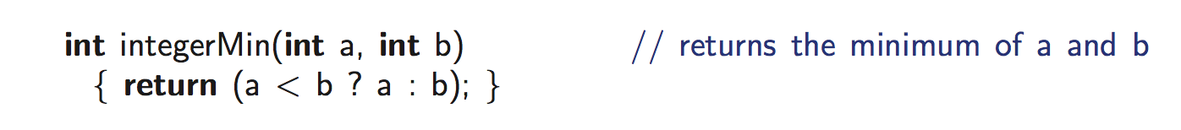
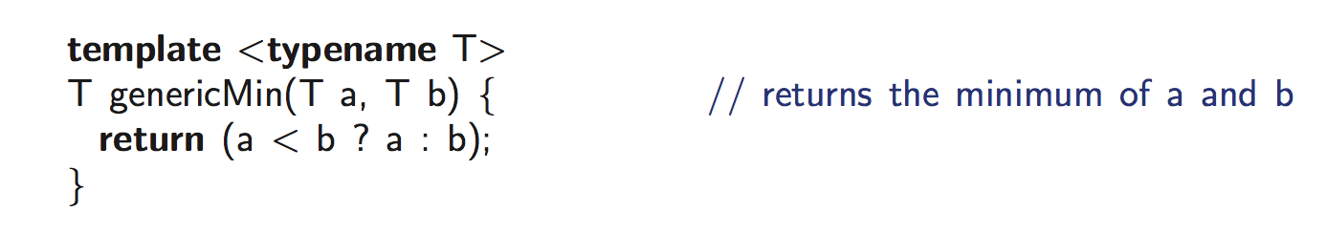
Function Template (1)
Useful, but what about min of two doubles?
  C-style answer: double doubleMin(double a, double b)
Function template is a mechanism that enables this
  Produces a generic function for an arbitrary type T.

Slide 136
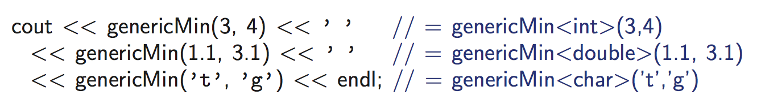
Function Template (2)

Slide 137
Function Overloading vs. Function Template
Function overloading
  Same function name, but different function prototypes
  These functions do not have to have the same code
  Does not help in code reuse, but helps in having a consistent name
Function template
  Same code piece, which applies to only different types
#include<iostream>
using namespace std;
int abs(int n) {
return n >= 0 ? n : -n;
}
double abs(double n) {
return (n >= 0 ? n : -n);
}
int main( ) {
cout << “absolute value of ” << -123;
cout << “ = ” << abs(-123) << endl;
cout << “absolute value of ” << -1.23;
cout << “ = ” << abs(-1.23) << endl;
}

Slide 138
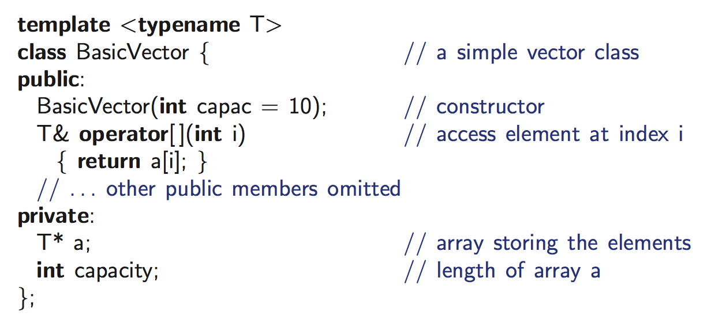
Class Template (1)
In addition to function, we can define a generic template class
Example: BasicVector
  Stores a vector of elements
  Can access i-th element using [] just like an array

Slide 139
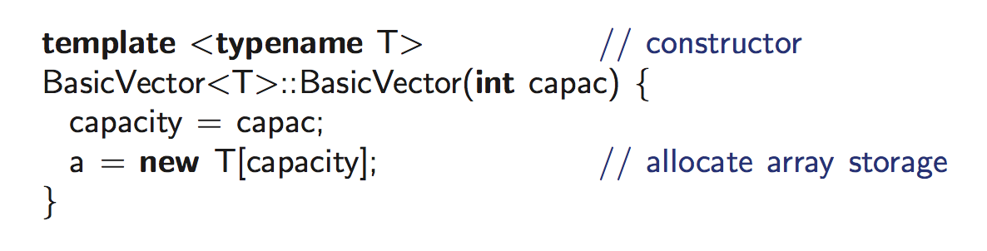
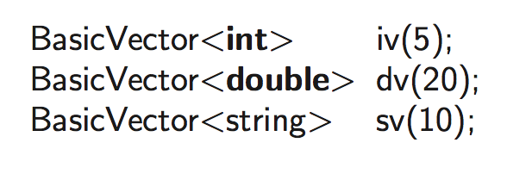
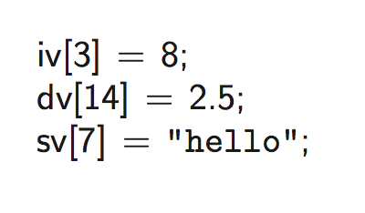
Class Template (2)
BasicVector
  Constructor code?
How to use?

Slide 140
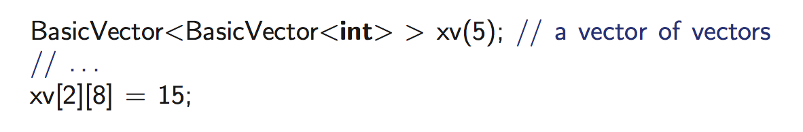
Class Template (3)
The actual argument in the instantiation of a class template can itself be a templated type
Example: Twodimensional array of int
BasicVector consisting of 5 elements, each of which is a BasicVector consisting of 10 integers
  In other words, 5 by 10 matrix

Slide 141
Exceptions

Slide 142
Exceptions: Intro
Exception
  Unexpected event, e.g., divide by zero
  Can be user-defined, e.g., input of studentID > 1000
  In C++, exception is said to be “thrown”
  A thrown exception is said to be “caught” by other code (exception handler)
  In C, we often check the value of a variable or the return value of a function, and if… else… handles exceptions
    Dirty, inconvenient, hard to read

Slide 143
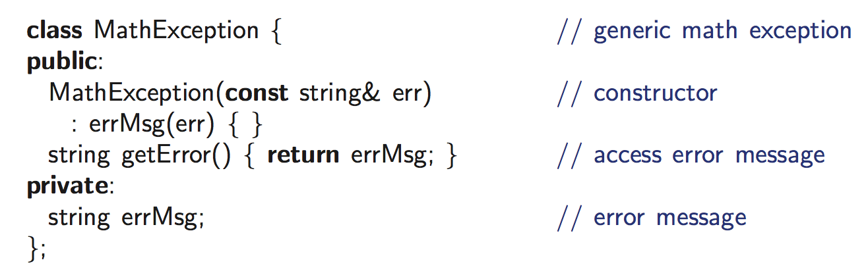
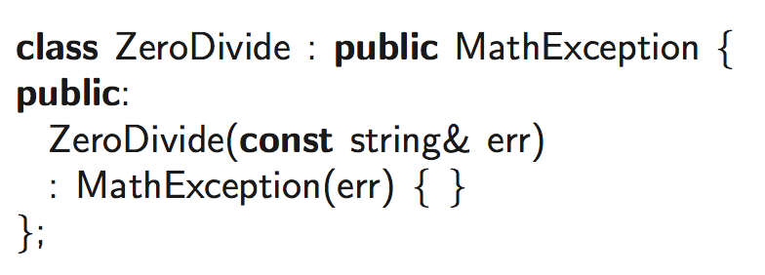
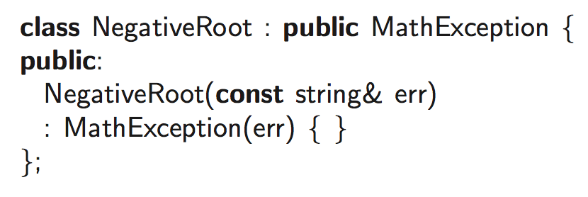
Exception: Also a class

Slide 144
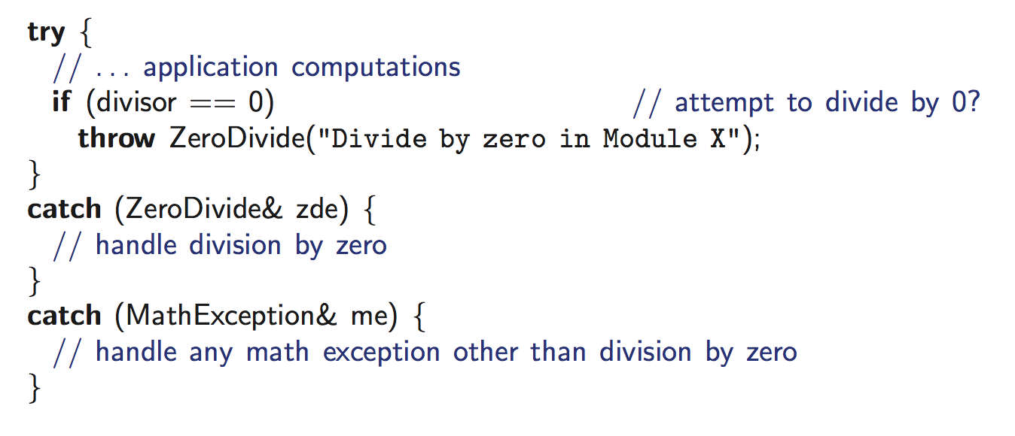
Exception: Throwing and Catching
ZeroDivide “is a” MathException? Yes

Slide 145
Exception Example (1)
#include <iostream>
using namespace std;
double division(int a, int b){
if( b == 0 ) {
throw "Division by zero condition!";
}
return (a/b);
}
int main () {
int x = 50; int y = 0; double z = 0;
try {
z = division(x, y);
cout << z << endl;
} catch (const char* msg) {
cerr << msg << endl;
}
return 0;
}

Slide 146
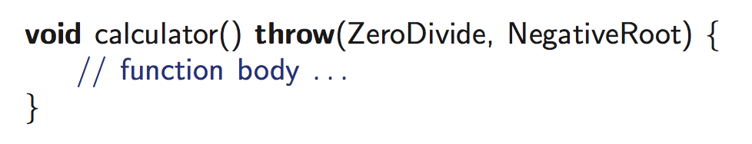
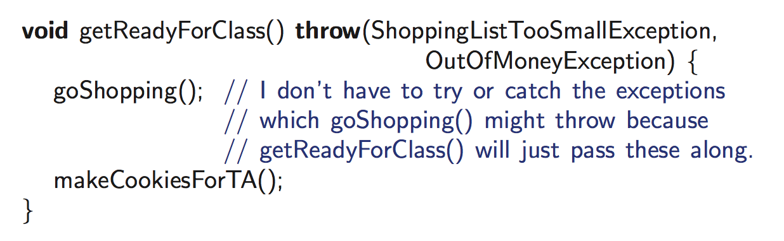
Exception Specification
In declaring a function, we should also specify the exceptions it might throw
  Lets users know what to expect
Exceptions can be “passed through”
The function calculator (and any other functions it calls)
can throw two exceptions or exceptions derived from these types

Slide 147
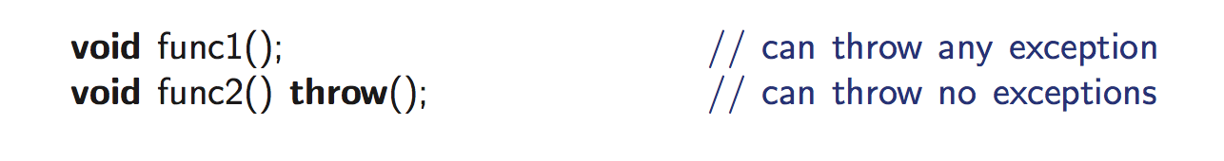
Exception: Any Exception and No Exception

Slide 148
C++ Standard Exceptions

Slide 149
Exception Example (2)
#include <iostream>
#include <exception>
using namespace std;
class MyException : public exception {
const char * what () const throw (){
return "C++ Exception";
}
};
int main()
{
try {
throw MyException();
}catch(MyException& e){
std::cout << "MyException caught" << std::endl;
std::cout << e.what() << std::endl;
} catch(std::exception& e){
//Other errors
}
}

Slide 150
Friend

Slide 151
Recall: Access Control
class AccessControl {
public:
int publicData;
void publicFunc( );
protected:
int protectedData;
void protectedFunc( );
private:
int privateData;
void privateFunc( );
};
int main( ) {
AccessControl ac;
ac.publicData = 1;
ac.publicFunc( );
ac.protectedData = 2;
ac.protectedFunc( );
ac.privateData = 3;
ac.privateFunc( );
};
( O )
( O )
( X )
( X )
( X )
( X )
public
protected
private
general users
derived classes & friends
own & friends
public:
protected:
private:

Slide 152
Friends to a Class
In some cases, information-hiding is too prohibitive.
  Only public members of a class are accessible by non-members of the class
“friend” keyword
  To give nonmembers of a class access to the nonpublic members of the class
Friend
  Functions
  Classes
class CCC
class AAA
function aaa()
class AAA
friend function aaa()
friend class BBB
I’m not AAA’s friend..
class BBB
can access nonpublic members of class AAA
can access nonpublic members of class AAA
I’m AAA’s friend!

Slide 153
Example: Friend Functions
#include<iostream>
using namespace std;
class point {
int x, y;
public:
point(int a = 0, int b = 0);
void print();
friend void set(point &pt, int a, int b);
};
point::point(int a, int b) {
x = a; y = b;
}
void point::print() {
cout << x << ", " << y << endl;
}
void set(point &pt, int a, int b) {
pt.x = a; pt.y = b;
}
int main() {
point p(1, 1);
p.print();
set(p, 2, 2);
p.print();
return 0;
}
call-by-reference
not “p.set( );”
result>
1, 1
2, 2
not member function,
but friend function

Slide 154
Friend Class
#include<iostream>
using namespace std;
class point {
int x, y;
friend class rectangle;
public:
void set(int a, int b);
};
void point::set(int a, int b) {
x = a; y = b;
}
class rectangle {
point leftTop, rightBottom;
public:
void setLT(point pt);
void setRB(point pt);
void print();
};
void rectangle::setLT(point pt) {
leftTop.set(pt.x, pt.y);
}
void rectangle::setRB(point pt) {
rightBottom.set(pt.x, pt.y);
}
void rectangle::print() {
cout << "LT:" << leftTop.x;
cout << "," << leftTop.y << endl;
cout << "RB:" << rightBottom.x;
cout << "," << rightBottom.y << endl;
}
int main() {
rectangle sq;
point lt, rb;
lt.set(1, 1); sq.setLT(lt);
rb.set(9, 9); sq.setRB(rb);
sq.print();
return 0;
}
point
can access whole member
rectangle
result>
LT:1, 1
RB:9, 9
friend class rectangle;
You’re my friend

Slide 155
Wrap Up
You may not have a big problem in reading the codes in the book
You may not have a big problem in doing the homework assignments
However,
  Be ready to debug your program
  Be ready to search more things in Google
  Be ready to meet “compilation errors”

Slide 156
Supplementary Materials

Slide 157
Example : Constructors
#include<iostream> using namespace std; #define MAX 10 class record { public: char name[MAX]; private: int course1, course2; double avg; public: record( ); void print(void); }; void record::print(void) { … }
 | record::record( ) { strcpy(name, ""); course1 = course2 = 100; avg = 100; } int main( ) { record yourRecord = { "HONG GD", 100, 100 }; yourRecord.print(); record myRecord = record::record( ); myRecord.print( ); return 0; }
Error
∵member variables in “private”

Slide 158
Example: Constructors & Destructors
#include<iostream> using namespace std; class record { public: char *name; private: int course1, course2; double avg; public: record(char *str = "", int s1 = 100, int s2 = 100); ~record(); void print(void); }; record::~record() { delete []name; } | record::record(char *str, int s1, int s2) { name = new char[strlen(str)+1]; strcpy(name, str); course1 = s1; course2 = s2; avg = ((double) (s1 + s2)) / 2; } void record::print(void) { … }
 | int main( ) { record *myRecord = new record( ); record *yourRecord = new record("KIM", 90, 100); myRecord->print( ); yourRecord->print( ); delete myRecord, yourRecord; return 0; }

Slide 159
Constructors with Arg. and Default Values
 |  | result> course1 = 100, course2 = 100 avg = 100 KIM course1 = 90, course2 = 90 avg = 90 LEE course1 = 100, course2 = 100 avg = 100
#include<iostream> using namespace std; #define MAX 10 class record { public: char name[MAX]; private: int course1, course2; double avg; public: record(char *str = "", int s = 100); void print(void); }; record::record(char *str, int score) { strcpy(name, str); course1 = course2 = score; avg = score; }
 | void record::print(void) { … } int main( ) { record myRecord; record yourRecord = record("KIM", 90); record hisRecord = "LEE"; myRecord.print( ); yourRecord.print( ); hisRecord.print( ); return 0; }
implicitly call with default values (default constructor)
shorthand notation
same as
record hisRecord = record(“LEE”);

Slide 160
A Special Constructor : Copy Constructor
#include<iostream> using namespace std; class point { public: int x, y; point(int _x, int _y) { x =_x; y = _y; } point(const point &pt) { x = pt.x; y = pt.y; } void set(int _x, int _y) { x = _x; y = _y; } void print(); }; | void point::print() { cout << x << "," << y << endl; } int main() { point p1(1, 1); point p2(p1); p1.set(2, 2); cout << "P1 : "; p1.print(); cout << "P2 : "; p2.print(); return 0; }
result> P1 : 2,2 P2 : 1,1
copy constructor
Syntax : X(const X& X1)

Slide 161
Default Copy Constructor
#include<iostream> using namespace std; class point { public: int x, y; point(int _x, int _y) { x =_x; y = _y; } void set(int _x, int _y) { x = _x; y = _y; } void print(); }; | void point::print() { cout << x << "," << y << endl; } int main() { point p1(1, 1); point p2(p1); p1.set(2, 2); cout << "P1 : "; p1.print(); cout << "P2 : "; p2.print(); } | result> P1 : 2,2 P2 : 1,1
same result
default copy constructor
- simply copies all members implicitly
- can be used without definition

Slide 162
Limitation of Default Copy Constructor
class record{ public: char *name; char *telephone; int age; ... }; | int main() { record myRecord; record hisRecord = myRecord; … }
calls default copy constructor
= record hisRecord(myRecord);
“myName”
myRecord
“myTelephone”
hisRecord
myRecord.name
hisRecord.name
Copying
hisRecord.telephone
myRecord.telephone
MY_AGE
MY_AGE
Shallow copy
Member variables of an object are two pointers (name and telephone) and one integer
Copied two pointer variables and one integer variable
Two points variables point to the same locations as ones in original objects.
One integer variable copies its own.

Slide 163
Deep Copy Constructor
“myName”
“myTelephone”
myRecord.name
hisRecord.name
myRecord.telephone
hisRecord.telephone
Copying
MY_AGE
MY_AGE
“myName”
“myTelephone”
Deep copy
Deep copy of two member variables of type pointers
→ Copied pointer variables points to different locations from ones in original ones.

Slide 164
Example: Deep Copy Constructor
#include<iostream> using namespace std; class record { public: char *name; char *tel; record(char *, char *); record(const record &); ~record(); void modifyTel(char *_tel); void print(void); }; record::record(char *_n, char *_tel) { name = new char[strlen(_n)+1]; strcpy(name, _n); tel = new char[strlen(_tel)+1]; strcpy(tel, _tel); }
 | record::record(const record &_record) { name = new char[strlen(_record.name)+1]; strcpy(name, _record.name); tel = new char[strlen(_record.tel)+1]; strcpy(tel, _record.tel); } record::~record() { delete name, tel; } void record::modifyTel(char *_tel) { delete tel; tel = new char[strlen(_tel)+1]; strcpy(tel, _tel); }
 |  | void record::print(void) { cout << name; cout << " : " << tel << endl; } int main( ) { record myRecord("KIM", "6565"); record hisRecord(myRecord); myRecord.modifyTel("5454"); myRecord.print( ); hisRecord.print( ); return 0; }
deep copy
result>
KIM : 5454
KIM : 6565

Slide 165
Static Members
class student {
public:
int id;
static int count;
student(int i = 0);
static void printCount( );
};
student myID, yourID;
per class
Static Members
(data, function)
student::count
student::printCount( )
myID
myID.id
myID.count
per object instance
myID.student( )
yourID
myID.printCount( )
yourID.id
yourID.count
per object instance
yourID.student( )
yourID.printCount( )

Slide 166
Example: Static Members (1/3)
#include<iostream> using namespace std; class student { public: int id; student(int i = 0); static void printCount(); private: static int count; }; int student::count = 0; student::student(int i) { id = i; count++; } | void student::printCount() { cout << "count = " << count << endl; } int main() { student myID = 20090001; myID.printCount(); student yourID; myID.printCount(); student hisID, herID; student::printCount(); }
result>
count = 1
count = 2
count = 4
Static member function can be accessed directly with class name
A static data member must be initialized outside the class definition in the same manner as a non-member variable
∵only one copy of static member
Access of a static member is syntactically identical

Slide 167
Example: Static Members (2/3)
#include<iostream> using namespace std; class student { public: int id; int order; student(int i= count); static void printCount(); private: static int count; }; int student::count = 0; student::student(int i) { order = i; count++; }
A static data member can appear as a default argument to a member function of the class.
(A non-static member cannot.)

Slide 168
Example: Static Members (3/3)
#include<iostream> using namespace std; class math { private: static int sum; static int facto; static int permu; public: math(){ sum = 0; facto = 0; permu = 0; } static int summation(int a); static int factorial(int a); static int permutation(int a, int b); }; int math::sum = 0; int math::facto = 1; int math::permu = 1; int math::summation(int a){ sum = 0; for(int i=0; i<=a; i++) sum += i; return sum; } | int math::factorial(int a){ facto = 1; while(a != 0){ facto *= a; a -= 1; } return facto; } int math::permutation(int a, int b){ permu = 1; permu = math::factorial(a) / math::factorial(a-b); return permu; } int main() { int result1, result2, result3; result1 = math::summation(5); result2 = math::factorial(4); result3 = math::permutation(6,2); cout << " sum: " << result1 << endl; cout << " factorial: " << result2 << endl; cout << " permutation: " << result3 << endl; return 0; }
result>
sum: 15
factorial : 24
permutation : 30
Static Member Variables Initialization
Calls of static Member functions

Slide 169
Const Keyword
Declare constant variables, pointers, member functions
Once initialized, the value of the const variables cannot be overriden.
int n1 = 10; int n2 = 20
const int* p1 = &n1; /* p1 is a pointer to a constant integer*/
p1 = &n2 ; /* ok! */
*p1 = 20;
Compile Error!
int* const p2 = &n1; /* p2 is a constant pointer to an integer*/
*p2 = 20; /* ok! */
p2 = &n2;
Compile Error!
const int* const p3 = &n1; /* p3 is a constant pointer to a constant integer */
*p3 = 20;
p3 = &n2;
Compile Error!
Compile Error!

Slide 170
Const Member Variables
#include<iostream> using namespace std; class record { public: const int id; int course1, course2; record(int i = 0, int s1 = 100, int s2 = 100); void print(void); }; record::record(int i, int s1, int s2) { id = i; course1 = s1; course2 = s2; } | void record::print(void) { cout << "ID : " << id << endl; cout << "course1 = " << course1; cout << ", course2 = " << course2 << endl; } int main( ) { record myRecord(20090001, 90, 100); myRecord.print( ); return 0; }
constant
assignment
(not initialization)
Error
record::record(int i, int s1, int s2)
: id(i)
{
course1 = s1; course2 = s2;
}

Slide 171
Const Member Functions
#include<iostream> using namespace std; class point { int x, y; public: point(int = 0, int = 0); void set(int, int) const; void print( ) const; }; point::point(int a, int b) { x = a; y = b; } | void point::set(int a, int b) const { x = a; y = b; } void point::print( ) const { cout << x << "," << y << endl; } int main( ) { point p(1, 1); p.print(); const point p2(2, 2); p2.set(3, 3); p2.print(); return 0; }
ERROR
∵x, y are non-constant
const Member Function: only applied to const data, not to non-const. data
ERROR
∵A const class object cannot
invoke non-const member functions.

Slide 172
Reference Member Variables (1/2)
#include<iostream> using namespace std; class record { public: int &id; int course1, course2; record(int i = 0, int s1 = 100, int s2 = 100); void print(void); }; record::record(int i, int s1, int s2) : id(i) { course1 = s1; course2 = s2; } | void record::print(void) { cout << "ID : " << id << endl; cout << "course1 = " << course1; cout << ", course2 = " << course2 << endl; } int main( ) { record myRecord(20090001, 90, 100); myRecord.print( ); return 0; }
reference
initialization
result>
ID : garbage
course1 = 90, course2 = 100

Slide 173
Reference Member Variables (2/2)
#include<iostream> using namespace std; class record { public: int &id; int course1, course2; record(int &i, int s1 = 100, int s2 = 100); void print(void); }; record::record(int& i, int s1, int s2) : id(i) { course1 = s1; course2 = s2; } | void record::print(void) { cout << "ID : " << id << endl; cout << "course1 = " << course1; cout << ", course2 = " << course2 << endl; } int main( ) { int common = 20090001; record Record1(common, 90, 100); record Record2(common, 70, 80); common = 20090002; Record1.print( ); Record2.print(); return 0; }
reference
initialization
result>
ID : 20090002
course1 = 90, course2 = 100
ID : 20090002
course1 = 70, course2 = 80

Slide 174
Inheritance VS. Nested Class
Nested | Has-a relation | A circle has a point.
Inheritance | Is-a relation | A student is a person.
class circle {
point center;
int radius;
...
};
Nested
point center;
int radius;
class circle : public point {
int radius;
...
};
Inheritance
Unnatural !
Left top point
Inheritance
How about with 2 points ?
Right bottom point

Slide 175
Example: Private Derivation
#include<iostream> using namespace std; class Parent { char *_lastname; public: char *_name; char* lastname() { return _lastname; } char* name() { return _name; } Parent(char *name = "", char *lastname = ""); ~Parent() { delete _name, _lastname; } }; Parent::Parent(char *name, char *lastname) { _name = new char[strlen(name)+1]; strcpy(_name, name); _lastname = new char[strlen(lastname)+1]; strcpy(_lastname, lastname); } | class Child : private Parent { public: Child(char *name = "", char *lastname = ""); }; Child::Child(char *name, char *lastname) : Parent(name, lastname) { } int main() { Child myRecord("JH", "KIM"); cout << "Name : " << myRecord._name << endl; cout << "Last name : " << myRecord._lastname << endl; return 0; }
 | Name : JH Last name : KIM
cout << "Name : " << myRecord.name() << endl;
cout << "Last name : " << myRecord.lastname() << endl;

Slide 176
Example: Type Conversion of Pointer (1)
 |  | ( O ) ( X ) ( X )
#include <iostream> using namespace std; class Person { public: void Sleep() { cout<<"Sleep"<<endl; } }; class Student : public Person { public: void Study() { cout<<"Study"<<endl; } }; class Undergraduate : public Student { public: void Research() { cout<<"Research"<<endl; } };
 | int main() { Person *p1 = new Person; Student *p2 = new Person; Undergraduate *p3 = new Person; p1->Sleep(); p2->Sleep(); p3->Sleep(); return 0; }

Slide 177
Example: Type Conversion of Pointer (2)
#include <iostream> using namespace std; class Person { public: void Sleep() { cout<<"Sleep"<<endl; } }; class Student : public Person { public: void Study() { cout<<"Study"<<endl; } }; class Undergraduate : public Student { public: void Research() { cout<<"Research"<<endl; } }; | int main() { Person *p1 = new Student; Person *p2 = new Undergraduate; Student *p3 = new Undergraduate; p1->Sleep(); p2->Sleep(); p3->Sleep(); return 0; }
( O )
( O )
( O )

Slide 178
Example: Type Conversion of Pointer (3)
#include <iostream> using namespace std; class Person { public: void Sleep() { cout<<"Sleep"<<endl; } }; class Student : public Person { public: void Study() { cout<<"Study"<<endl; } }; class Undergraduate : public Student { public: void Research() { cout<<"Research"<<endl; } }; | int main() { Person *p1 = new Person; Person *p2 = new Student; Person *p3 = new Undergraduate; p1->Sleep(); p2->Sleep(); p3->Sleep(); return 0; }
( O )
( O )
( O )

Slide 179
Overriding and Overloading
 | class Child : public Parent { public: void print( ) { cout << "I'm your son." << endl; } };
#include<iostream> using namespace std; class Parent { public: void print( ) { cout << "I'm your father." << endl; } void print(int i) { for (int j = 0; j < i; j++) cout << "I'm your father." << endl; } };
 | int main() { Child child; child.print( ); child.print(3); return 0; }
overriding
Overloading
(within class)
ERROR

Slide 180
Multiple Inheritance
In C++, a class can have more than one immediate bass class
  Not supported in JAVA
Multiple Inheritance
  The use of more than one immediate base class
    Inheritance tree → Inheritance graph with no cycle
  Usage
    class child : public parent1, public parent2 { … }
  Combined two unrelated classes together as a part of an implementation of a third class
  Conflict of names: Two base classes have a member function with the same name
    To resolve ambiguity, use following expression
      parent class name : : function()
    Ex. when two parents have the same function A()
ch->A(); // error → Ambiguity for inheritance
ch->parent1::A(); // ok
ch->parent2::A(); // ok

Slide 181
Example : Multiple Inheritance
#include<iostream> using namespace std; class Output { public: Output(){} void Print() { cout << contents << endl;} protected: char contents[20]; }; class IntInput { public: IntInput(){} void In() { cin >> number; } protected: int number; };
 | class IO : public Output, public IntInput { public: IO(){} void Delivery(){ sprintf(contents, "%d", number); } };
 | int main() { IO *a = new IO(); cout << ”Input : "; a->In(); // from IntInput class a->Delivery(); // from IO class cout << ”Output : "; a->Print(); // from Output class return 0; }
Result>
Input : 10
Output : 10

Slide 182
Heterogeneous List
Homogenous List
  List of objects in the same class (type) → Implementation in array
Heterogeneous List
  List of objects in different classes
  Use points to objects in base class and derived classes → array of pts
  Uniform interface for objects in different classes
class Parent { public: virtual void vpr( ) { cout << ”vpr: parent" << endl; } }; class Child : public Parent { public: void vpr() { cout << ”vpr: child" << endl; } };
 | Parent par1, par2; Child son1, son2; Parent *list[4 ]; list[0] = &par1; list[1] = &son1; list[2] = &son2; list[3] = &par2;
vpr( ): parent
vpr( ): child
vpr( ): child
vpr( ): parent
Heterogeneous List
in uniform interface
for (int i = 0; i < 4; i++)
list[i] -> vpr( );

Slide 183
Pure Virtual Functions and Abstract Class
#include<iostream> using namespace std; class Parent { public: virtual void print( ) = 0; }; class Child : public Parent { public: void print( ) { cout << "I'm your son." << endl; } };
Pure virtual function
1. A virtual function is made “pure” by the initialzer = 0.
2. A virtual function cannot be called within an abstract class.
Abstract class
1. A class with one or more pure virtual functions
2. No object from class is created.
3. Means to provide an interface without exposing any
implementation details

Slide 184
Example: Pure Virtual Functions
 | int main() { Parent parent; parent.print( ); Child child; child.print( ); child.Parent::print( ); return 0; }
#include<iostream> using namespace std; class Parent { public: virtual void print( ) = 0; }; class Child : public Parent { public: void print( ) { cout << "I'm your son." << endl; } };
ERROR
ERROR
∵ Cannot invoke a virtual function
∵ No objects of an abstract class can be created.

